Slide 1
Genomic Alterations in the Mitochondrial Genes of Breast Cancer Cells
Rohan Wedam

Slide 2
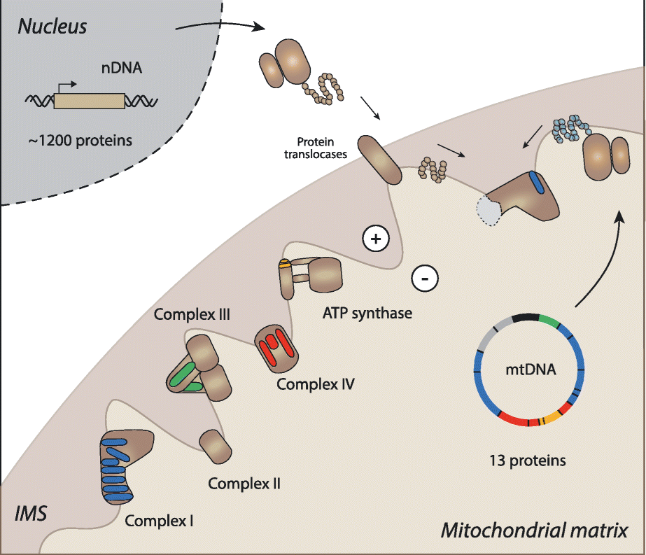
Background
In 2018, our group published a paper on ONC201 and how it disrupts both the structure and function of mitochondria to kill breast cancer cells [1].
Mitochondria are membrane bound organelles with the primary purpose of producing most of the chemical energy for a cell in the form of ATP.
Mitochondrial genes are encoded by the nuclear genome (nDNA) for the most part but a few are encoded by the mitochondrial genome. The mitochondrial DNA (mtDNA) has 37 genes and codes for 13 proteins, tRNAs and ribosomal RNAs. The nuclear DNA encodes ~1121 mitochondrial genes.

Slide 3
Hypothesis
Mitochondrial Genes will be genetically aberrant in a subset of breast cancer cells.
Subhypothesis
a) Identifying genes with genetic abnormalities may identify breast cancers that are most susceptible to mitochondrial inhibition (e.g. more or less susceptible to ClpP agonists).
b) Identifying mitochondrial genes with genetic abnormalities may identify other novel targets for disrupting mitochondrial function in cancer cells.

Slide 4
Methods – Human MitoCarta2.0
The 1158 genes in the Human MitoCarta2.0 inventory, an inventory of genes with strong evidence for mitochondrial localization, were used [2][3].
MitoCarta evidence is based on the following sources: Literature, APEX Matrix, APEX IMS, GFP, TargetP signal, Yeast Mito Homolog, Rickettsial Homolog, Mitochondrial Protein Domain, Induction, Coexpression, and MS/MS.
MS/MS looks at the following 14 mouse tissues: Cerebrum, Cerebellum, Brainstem, Spinal Cord, Liver, Kidney, Heart, Skeletal Muscle, Adipose, Stomach, Small Intestine, Large Intestine, Testis, and Placenta.
https://www.broadinstitute.org/files/shared/metabolism/mitocarta/human.mitocarta2.0.html
https://www.broadinstitute.org/mitocarta/mitocarta20-column-documentation

Slide 5
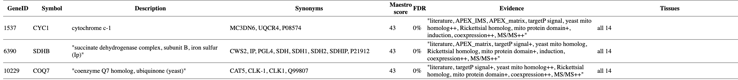
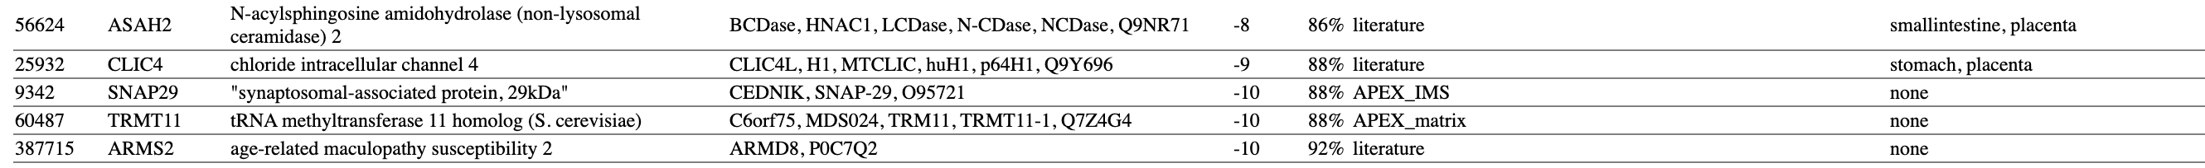
Human MitoCart2.0 Gene List
Genes at the top of the list with high confidence of mitochondrial localization as seen with low false discovery rate (FDR), high Maestro score and multiple pieces of corroborating evidence.
Genes at the bottom of the list with lower confidence of mitochondrial localization and thus the exact opposite characteristics of high confidence genes.
https://www.broadinstitute.org/files/shared/metabolism/mitocarta/human.mitocarta2.0.html

Slide 6
Methods - cBioPortal
For analysis, cBioPortal was used to look at the genetic abnormalities in the genes compiled in MitoCarta2.0.
Two data sets that look at abnormalities in breast cancer were used to look the abnormalities in the MitoCarta2.0 genes.
The Molecular Taxonomy of Breast Cancer International Consortium (METABRIC)(Nature 2012 & Nat Commun 2016, 2509 patients).
The Cancer Genome Atlas (TCGA) (Cell 2015, 817 patients)
The abnormalities that were analyzed were the frequency of amplification, homozygous deletion, and point mutations of a gene.
https://www.cbioportal.org/

Slide 7
Methods – Initial Organization of Data
The CNA and mutation data from TCGA and METABRIC was downloaded as CSV files and imported to Excel.
The Excel VBA function XLOOKUP (lookup, lookup_array, return_array) was used to search the list of genes in either TCGA or METABRIC (lookup_array) to match the amplification, deletion, and mutation data (return_array) with the list of genes from MitoCarta2.0 (lookup).
This setup a list for TCGA and for METABRIC with amplification, deletion and mutation for each gene.

Slide 8
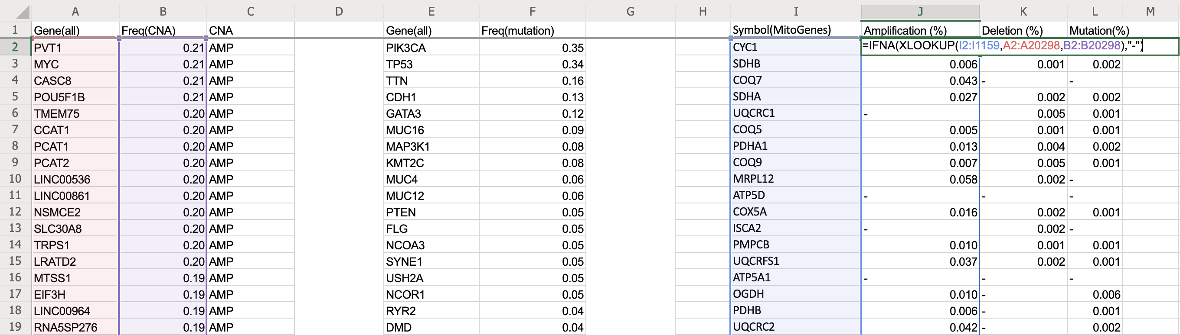
Data Organization with Excel VBA
XLOOKUP (lookup, lookup_array, return_array) to get Amplification for TCGA
lookup = MitoCarta2.0 gene list (Column I), lookup_array = list of all genes in TCGA (Column A), return_array = frequency value (Column B)
Use of the XLOOKUP formula to extract frequency of abnormalities from the raw TCGA data to match with the MitoCarta Genes.

Slide 9
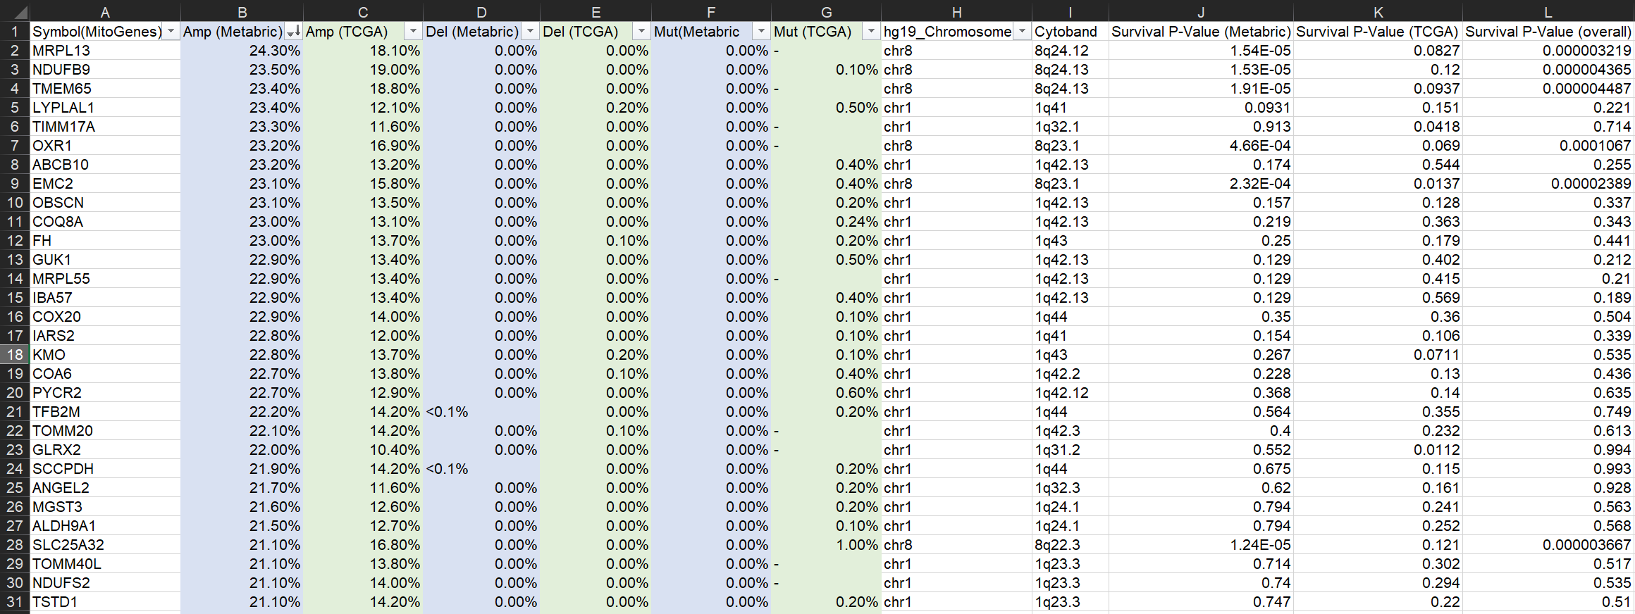
Genomic Alterations in Mitochondrial Genes
The first 30 genes of the 167 genes which have amplification ≥5%. The data is sorted from largest to smallest in amplification from METABRIC (Column B). Note that METABRIC did not look at mutation.

Slide 10
Methods – Finding Trends and Narrowing Data
Amplification had the most significant data so it was used to narrow down the genes with significance in mitochondrial function
The list of mitochondrial genes was narrowed down to those with frequency of amplification of ≥ 5%. This resulted in a list of 167 genes.
Of the genes with ≥ 5%, their survival p-value was recorded.
Survival p-value came from cBioPortal with a statistically significant value being p<0.05.

Slide 11
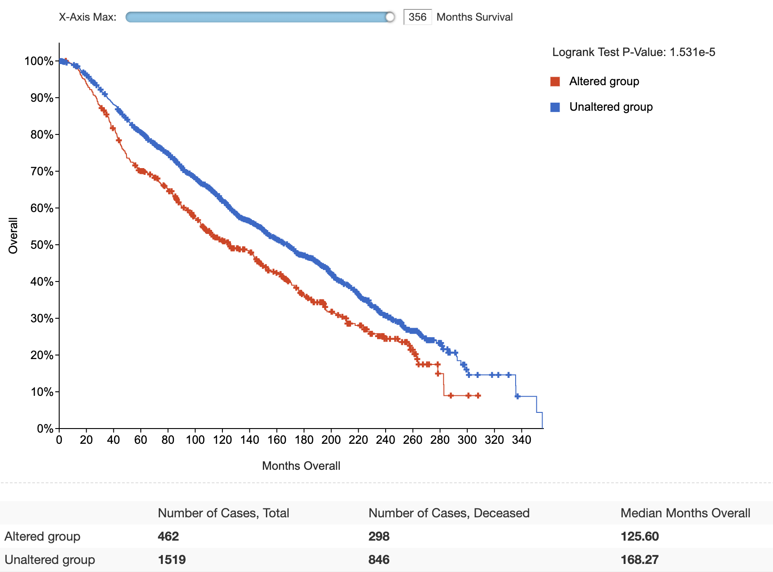
Survival Kaplan – Meier Curve for NDUFB9

Slide 12
Methods – Chromosome Location, Localization and Function
Cytoband data from the CNA data downloaded from cBioPortal showed the location of genes on chromosomes.
Localization and Function information was also recorded for the genes with p<0.05.
Localization information came from UniProt and Human Protein Atlas and function information came from UniProt.
https://www.uniprot.org/ https://www.proteinatlas.org/

Slide 14
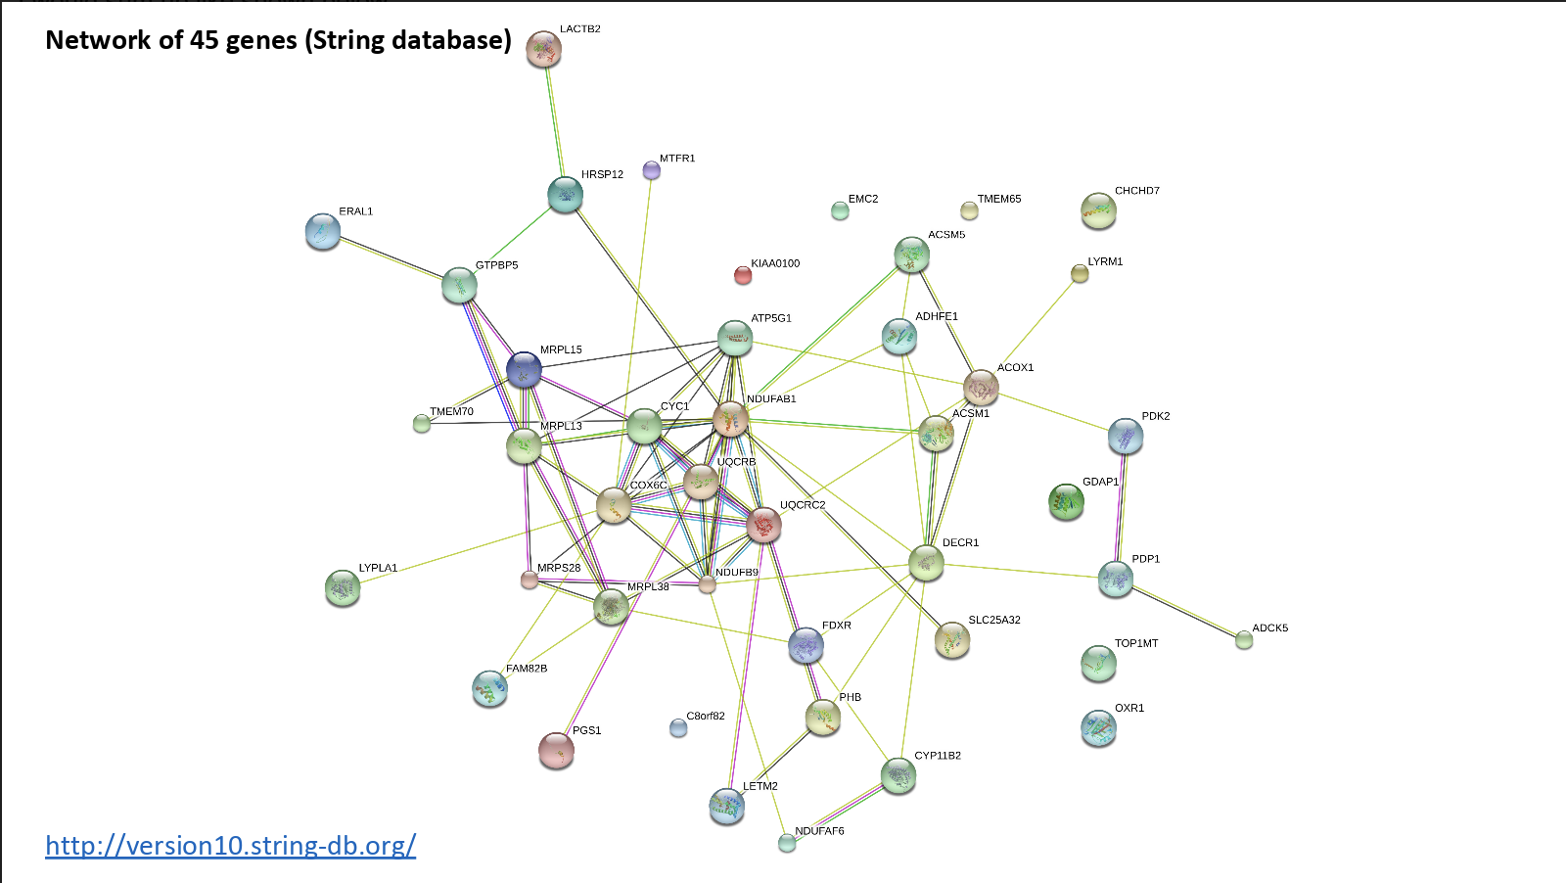

Slide 15
Addition of Cytoband and Survival Data to Genomic Alteration Data

Slide 16
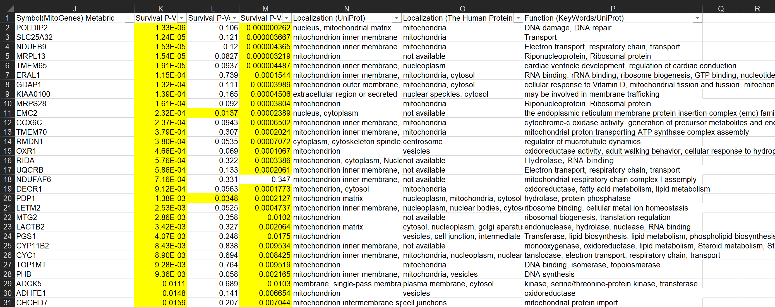
Survival, Localization and Function of Mitochondrial Genes
Survival P-Value
METABRIC
TCGA
Overall
The highlighted values are the p-values that are <0.05. In Metabric there was a total of 45 genes

Slide 17
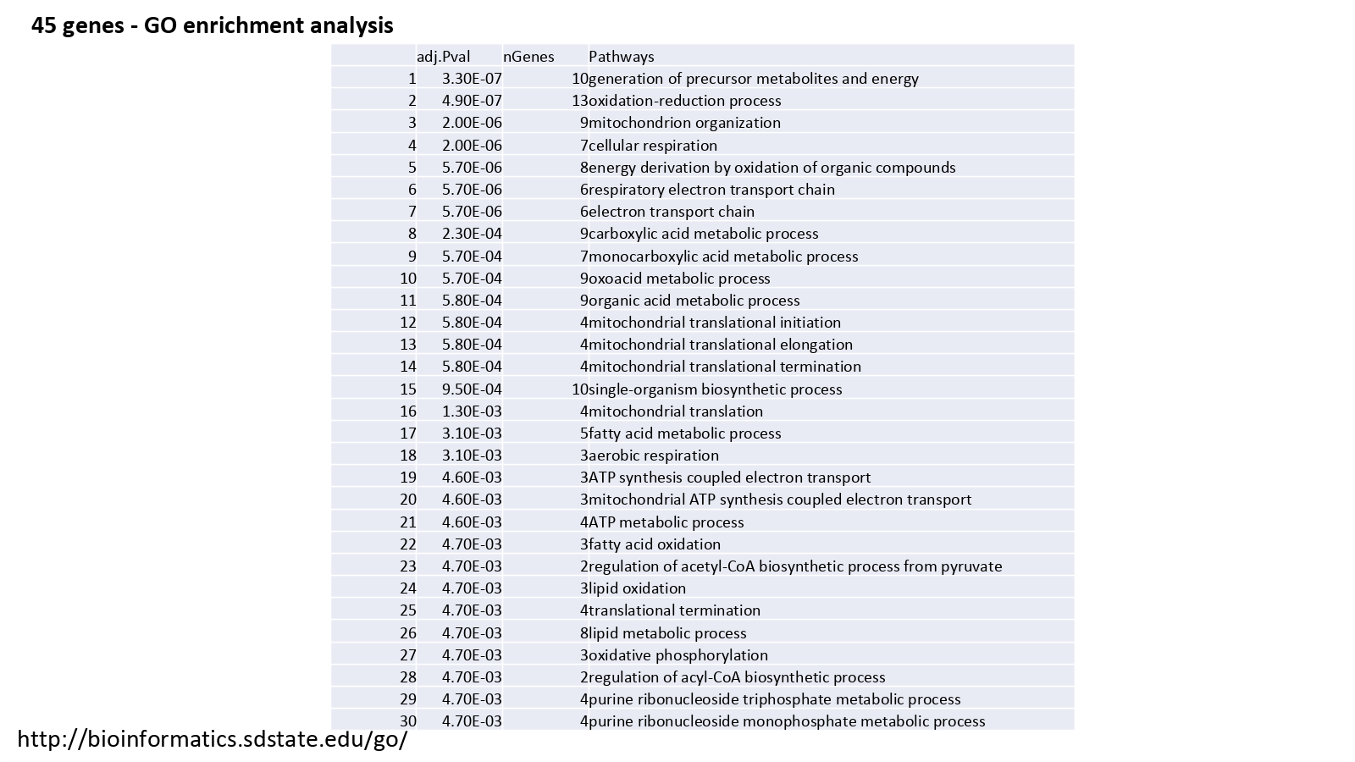

Slide 18
Summary
Of the 1158 genes from MitoCarta2.0, the list was narrowed down to 167 genes with amplification of ≥ 5%. This list was then narrowed down to 45 genes with surival p<0.05.
90% of the genes were in chromosome 1, 8, 16 or 17 and 49% of the genes were in chromosome 1 or 8.
In the 45 genes from METABRIC, the frequency of amplification was related to significant statistical difference (p<0.05) in patient survival
Many of these genes are related to electron transport chain and mitochondrial translation
Some concerns
When looking at survival, because it was over such a long time, death could be due to causes other than cancer.
Genes that are amplified could have been co-amplified with other genes but not be important.

Slide 19
Next Steps
Need to find genes worth manipulating. For example, knocking out a gene that is highly amplified.
This is genome analysis, but what transcriptome analysis is there to be done.
Based on genetic abnormalities, are they expressed and do they impact outcomes?

Slide 20
Looking at mRNA as Next Steps
Logically, higher amplification leads to higher expression but the only way to be sure is by looking at mRNA.
Some cases will have amplification of a gene but not a higher expression of mRNA. These cases would not be important in our experiment.
Thus, it is necessary to look at the overlap in higher mRNA expression and amplification.

Slide 21
Citations
Greer, Y., Porat-Shliom, N., Nagashima, K., Stuelten, C., Crooks, D., Koparde, V., Gilbert, S., Islam, C., Ubaldini, A., Ji, Y., Gattinoni, L., Soheilian, F., Wang, X., Hafner, M., Shetty, J., Tran, B., Jailwala, P., Cam, M., Lang, M., Voeller, D., Reinhold, W., Rajapakse, V., Pommier, Y., Weigert, R., Linehan, W. and Lipkowitz, S., 2018. ONC201 kills breast cancer cells in vitro by targeting mitochondria. Oncotarget, 9(26), pp.18454-18479.
Calvo, S.E., Klauser, C.R., Mootha, V.K. MitoCarta2.0: an updated inventory of mammalian mitochondrial proteins (2015). Nucleic Acids Research [doi: 10.1093/nar/gkv1003]
Pagliarini, D.J., Calvo, S.E., Chang, B., Sheth, S.A., Vafai, S.B., Ong, S.E., Walford, G.A., Sugiana, C., Boneh, A., Chen, W.K., et al. (2008). A mitochondrial protein compendium elucidates complex I disease biology. Cell 134, 112-123. [Pubmed: 18614015]

